Slide 1
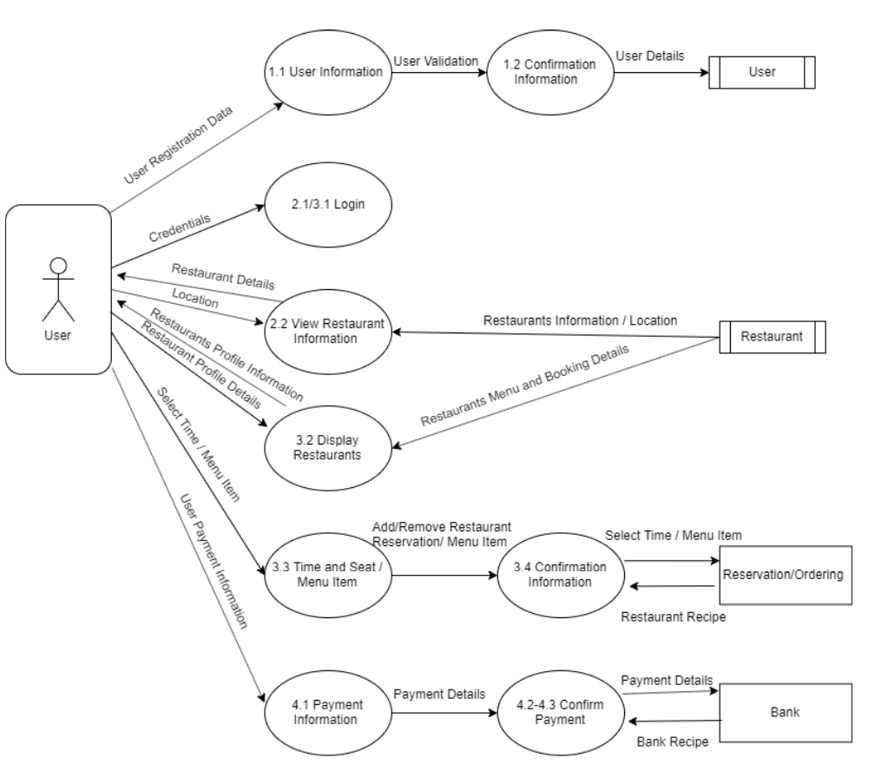
Super Servoli Systems - Data-flow Diagram (Physical)

